Slide 1
Board of State and Community Corrections (BSCC) Organized Retail Theft Vertical Prosecution Grant Program Bidders’ Conference
May 10, 2023 | 10:00 AM

Slide 2
Welcome and Introductions
Amanda Abucay, Staff Services Manager I
Michael Lee, Research Data Specialist I
Ricardo Goodridge, Deputy Director

Slide 3
Agenda
BSCC Overview
Grant Program Background
Review of Key RFP Components
Proposal Rating Factors & Process
Proposal Submission Process
Key Takeaways

Slide 4
BSCC Overview
Reports directly to the Governor's Office.
Organized under a Governor appointed Board made up of 13 members.
Provides statewide leadership, coordination, and technical assistance to promote effective state and local efforts and partnerships in California’s adult and juvenile criminal justice system, including providing technical assistance and coordination to local governments related to public safety.

Slide 5
BSCC Divisions
Corrections Planning and Grant Programs (CPGP)
State and Federal Grant Programs
Standards and Training for Corrections (STC)
Selection, Training and Standards
County Facilities Construction (CFC)
Construction Financing for Facilities
Facilities Standards and Operations (FSO)
Inspections, Regulations, Compliance Monitoring
Administration, Legal, and Research Units
Cross Agency Support

Slide 6
Organized Retail Theft Vertical Prosecution Grant Program
Established in the State Budget Act of 2022 (Assembly Bill 178)
Competitive Grant Program
Open to California District Attorneys
$28,500,000 available
NOTE: The Organized Retail Theft Prevention Grant Program Bidder’s Conference is scheduled for Thursday, May 11 at 10:00 AM

Slide 7
Key Dates
Request for Proposal (RFP) Released - April 14, 2023
Bidders’ Conference - May 10, 2023
Non-Binding Letters of Intent Due May 15, 2023
Proposals Due July 7, 2023, by 5:00 p.m. (PST)

Slide 8
General Information
A copy of this PowerPoint Presentation and Recording will be posted at: https://www.bscc.ca.gov/organized-retail-theft-vertical-prosecution-grant-program/
A Frequently Asked Questions (FAQ) document will be posted at: https://www.bscc.ca.gov/organized-retail-theft-vertical-prosecution-grant-program/
Questions may be submitted to: ORT@bscc.ca.gov

Slide 9
Questions
?

Slide 10
Review of Key RFP Components
Topics:
Grant Purpose
Project Description
Funding
Evaluation
Disqualifications

Slide 11
Grant Purpose
Fund a competitive grant program for district attorneys that addresses increased levels of retail theft property crimes using a vertical prosecution model.

Slide 12
Vertical Prosecution
For this grant, vertical prosecution means a prosecutor is assigned to an organized retail theft case from beginning to end (e.g., initial hearing/arrangement to sentencing).
Under this model, the victim(s), witness(es), and impacted law enforcement official(s) have a single point of contact throughout the process.

Slide 13
Legislative Requirements (AB 178)
Personnel
Dedicate at least one deputy district attorney and one district attorney investigator whose primary role is the investigation and prosecution of organized retail theft crimes.
Data - Provide the BSCC with:
Annual data on the number of organized retail theft cases filed by that county.
Number of organized retail theft convictions obtained, and the sentences imposed for those convicted of organized retail theft in that county.

Slide 14
Legislative Requirements (Cont’d)
Number of instances where vertical prosecution was used to obtain those convictions and the sentences imposed.
Number of theft-related property crimes that were charged overall in the jurisdiction that did not use the vertical prosecution model and the resulting number of convictions.

Slide 15
Eligibility
California District Attorneys
Applications must be submitted by the Board of Supervisors or the Chief County Administrative Officer
Limit of One Proposal Submission
Instruction Packet, Page 5

Slide 16
Grant Period
October 1, 2023 to June 1, 2027
Implementation | Service Delivery | Service Delivery | Service Delivery | Data Evaluation/Closeout
Up to 6-Months | Year 1 | Year 2 | Year 3 | Up to 6-Months
October 1, 2023 - April 1, 2024 | Start Date - December 31, 2024 | January 1, 2025 - December 31, 2025 | January 1, 2026 - December 31, 2026 | January 1, 2027 - June 1, 2027
Implementation period for hiring, procurement, and other activities that facilitate a timely start. Grantees who do not need the full implementation period can begin service delivery at any time once under contract. | Service delivery and data collection | Service delivery and data collection | Service delivery and data collection | Data analysis and evaluation period to analyze data gathered during the service delivery period. Only expenses incurred for evaluation efforts may be incurred in this period.
Instruction Packet, Pages 5-6

Slide 17
Non-Governmental Organizations (NGOs)
Criteria for NGOs
All Applicants must complete and submit
If N/A or unknown, indicate on the form and sign
Instruction Packet, Page 7

Slide 18
Funding
$28,500,000 available competitively
Applicants may apply under the Small Scope or Large Scope category
Applicants may apply for any dollar amount up to and including the maximum grant amount identified in the Small Scope or Large Scope category
Instruction Packet, Page 8

Slide 19
Funding Thresholds
Prepare a budget for either the Small or Large Scope category
Budget must cover October 1, 2023 - June 1, 2027
Funding Categories | Maximum Grant Award | Total Available Funding*
Small Scope | Up to $800,000 | $8,000,000
Large Scope | Up to $2,050,000 | $20,500,000
Total Funding for Competitive Grants: |  | $28,500,000
*Provided funding is appropriated in the FY 2023-2024 and 2024-25 State Budget Acts
Instruction Packet, Page 8

Slide 20
Eligible Funding Activities
Include, but not limited to, the following:
Case Management Systems
Computers/Laptops/Tablets
Databases
Hiring Staff and/or Contractors
Investigative Software
Online and Print Advertising
Staff expenses, including overtime
Instruction Packet, Page 9

Slide 21
Funding Requests
Budget must last for the entire grant period
No Match Requirement
Proposals will be scored in part on the reasonableness of the budget
Only Request What is Needed

Slide 22
Questions
?

Slide 23
Budget Attachment Overview
Completing the Excel Budget Attachment
Presentation by Amanda Abucay, Staff Services Manager I

Slide 24
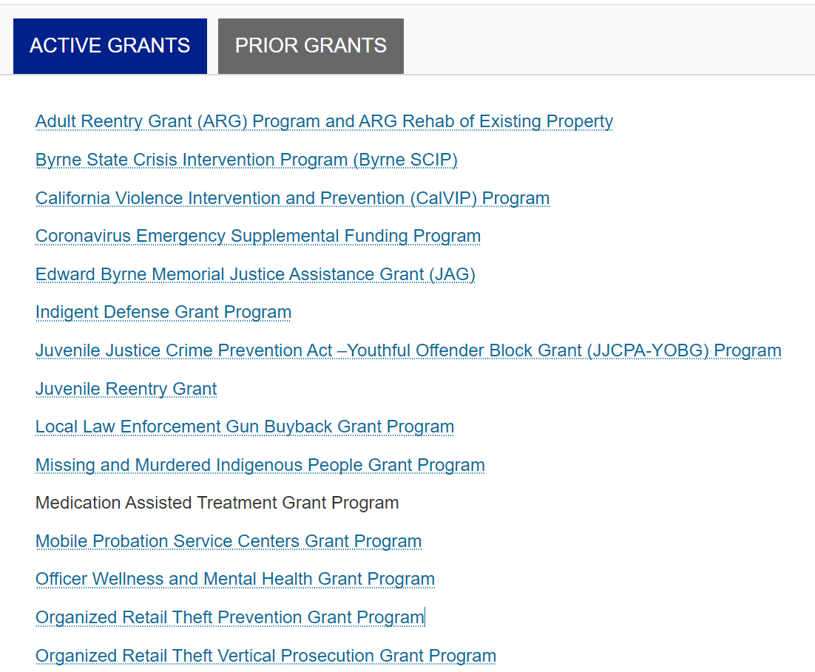
Budget Attachment Location
Visit the Corrections Planning and Grants Program Division Webpage -
https://www.bscc.ca.gov/s_correctionsplanningandprograms/
The Organized Retail Theft Vertical Prosecution Grant Program is listed alphabetically

Slide 25
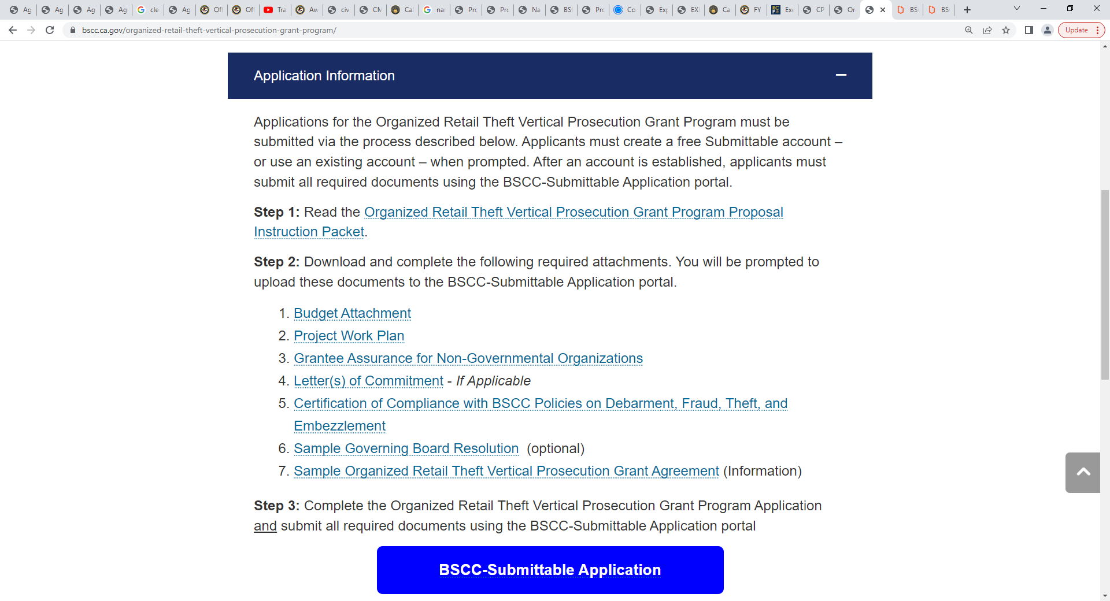
Budget Attachment Location (Cont’d)
Click “Application Information” to view the application, attachments, and other information
The Budget Attachment is located under Step 2, Item 1
Click on the Budget Attachment and an Excel file will open

Slide 26
Budget Attachment - Instructions Tab
Before starting your budget, please review the “Instructions” tab
Instructions for completing the Budget Attachment, including detailed information on budget line items, can be found here.

Slide 27
Budget Attachment - Project Budget Tab
Select the Project Budget tab to fill out the Project Budget and Budget Narrative.
Enter the Name of the Applicant.

Slide 28
Completing the Project Budget Tab
The budget table will auto-populate based on the information entered in each budget category
Only cells with no shading are fillable. All other cells are locked
Please request funds in whole dollars, no decimals
Provide narrative for each line item in which you are requesting funds

Slide 29
Saving the Budget Attachment
Save your completed budget workbook as an Excel document to allow for submission in Submittable.
Acceptable file types: .csv, .xls, .xlsx
Notes:
.

Slide 30
Upload the Budget Attachment to Submittable

Slide 31
Questions
?

Slide 32
General Grant Requirements
Audit Requirements
Grantees are required to provide the BSCC with a financial audit that covers the service delivery period of the grant (October 1, 2023 - December 31, 2026).
BSCC Grant Agreement
Applicants approved for funding are required to enter into a Grant Agreement with the BSCC and comply with all terms and conditions of the Grant Agreement
Grantee Assurance for Non-Governmental Organizations
Certification required from all applicants (Appendix D)
Debarment, Fraud, Theft or Embezzlement
Certification required from all applicants (Appendix F)
Instruction Packet, Pages 11-14

Slide 33
General Grant Requirements (Cont’d)
Governing Board Resolution
No payment will be issued until the Governing Board Resolution has been received
Sample Governing Board Resolution (Appendix G)
Grantee Orientation
Additional information will be provided to successful applicants
Invoices
Disbursement of grant funds occurs on a reimbursement basis
Grantees must maintain supporting documentation for all costs claimed on invoices
Monitoring
Projects will be monitored to assess whether the project is following grant requirements and making progress toward grant objectives.
Instruction Packet, Pages 11-14

Slide 34
General Grant Requirements (Cont’d)
Progress Reports
Grant award recipients are required to submit quarterly progress reports to the BSCC
Additional information will be provided to successful applicants
Supplanting
Grant funds shall be used to support new program activities or to augment or expand existing program activities but shall not be used to replace existing funds
Travel
Units of government may follow either their own written travel and per diem policy or the State’s policy.
Out-of-state travel is restricted and only allowed in exceptional situations, BSCC approval required
Instruction Packet, Pages 11-14

Slide 35
Overview of the RFP Process
Applicants will receive a confirmation email
A Scoring Panel will be convened to read and rate proposals and develop funding recommendations for the BSCC Board.
Unless disqualified, proposals will advance to the Scoring Panel for funding consideration
BSCC Board will consider funding recommendation in September 2023
Instruction Packet, Page 14

Slide 36
Disqualification
The following will result in an automatic disqualification:
Electronic proposal packet is not received by 5:00 p.m. PST on July 7, 2023
Applicant does not meet the Eligibility Criteria
Funding request exceeds allowable amounts
Budget Attachment (Excel document) is incomplete, or the total amount included in the budget table does not match the requested amount included elsewhere in the application.
Instruction Packet, Page 14

Slide 37
Disqualification (Continued)
The following will result in an automatic disqualification:
Proposal Package does not contain the following sections:
Proposal Narrative, Required Attachments, Budget Attachment (in Excel)
Electronic attachments are illegible
Electronic attachments will not open or are corrupted
NOTE: Disqualification means that the proposal will not move forward to the Scoring Panel for the Proposal Rating Process, and, therefore, will NOT be considered for funding.
Instruction Packet, Page 14

Slide 38
Questions
?

Slide 39
Proposal Rating Factors & Process
Presentation by Michael Lee, Research Data Specialist

Slide 40
Request for Proposal (RFP) Process
Submit proposal
Technical compliance review
Proposals forwarded to the Scoring Panel
Scoring Panel reads and scores proposals
Scoring Panel recommendations go to Board
Applicants notified of results

Slide 41
Scoring Panel
For this RFP, a Scoring Panel will be convened with the responsibility of:
Rating the proposals using transparent and fair measurement principles
Making funding recommendations to the Board

Slide 42
Rating Factors and Scores
 | Rating Factors | Point Range | Percent of Total Value | Weighted Rating Factor Score*
1 | Need | 0-5 | 10% | 20
2 | Description | 0-5 | 35% | 70
3 | Organizational Capacity and Coordination | 0-5 | 25% | 50
4 | Evaluation and Monitoring | 0-5 | 10% | 20
5 | Budget | 0-5 | 20% | 40
Maximum Proposal Score: |  |  | 100% | 200
Instruction Packet, Page 15

Slide 43
Proposal Rating Process
Six Point Rubric
Instruction Packet, Page 16

Slide 44
Rating Factors
The Scoring Panel will evaluate the merits of each proposal received in terms of how well each applicant responds to the rating factors found in the:
Project Need
Project Description
Project Organizational Capacity and Coordination
Project Evaluation and Monitoring
Budget
Instruction Packet, Pages 17-22

Slide 45
Rating Factor: Project Need
Project Need: The applicant described a need that is pertinent to the intent of the grant. The elements that comprise this Rating Factor are listed below. Addressing each element does not in itself merit a high rating; rather, although each element is to be addressed (when applicable), it is the quality of the response to each that will be evaluated. The response will be evaluated with a single rating based on a scale of 0-5.
1.1 | Describe the need(s) to be addressed, the process used to determine the need(s), and how the need is related to the intent of the grant program.
1.2 | Use relevant local qualitative and/or quantitative data with citations to demonstrate the nature and scale of the specific organized retail theft crimes problem and provide a compelling justification for grant funds
1.3 | Describe the existing hurdles of implementing a vertical prosecution model in the jurisdiction to prosecute organized retail theft crimes without the grant funds.
Section 1: Project Need
Percent of Total Value - 10%

Slide 46
Rating Factor: Project Description
Project Description: The applicant provided a description of the project that is related to the identified need and the intent of the grant. The elements that comprise this Rating Factor are listed below. Addressing each element does not in itself merit a high rating; rather, although each element is to be addressed (when applicable), it is the quality of the response to each that will be evaluated. The response will be evaluated with a single rating based on a scale of 0-5.
2.1 | Describe the vertical prosecution methodology that will be implemented to address the need(s) identified in the Project Need section. The description should also include: the dedicated staff (at least one deputy district attorney and one district attorney investigator) whose primary role is the investigation and prosecution of organized retail theft crimes. the target area and/or population which will be the focus of the project, including how and why it was selected. how the proposed project will address the Project Need and the intent of the grant program. plans to collaborate with online marketplaces and retailers to address the Project Need and organized retail theft property crimes, if applicable. plans to use alternatives to incarceration, including diversion or restorative justice programs, to address the Project Need and reduce recidivism.
2.2 | Describe the proposed project’s goals, objectives, and impact that includes a relationship to the identified need(s) and intent of the grant program. The completed Project Work Plan (Appendix B) is appropriate for the proposed project aligning with the identified need(s) and intent of the grant program. The completed Project Work Plan identifies the top goals and objectives (see Appendix C for definitions) and how those will be achieved in terms of the activities, responsible staff/partner agencies, process and outcome measures, data sources, and start and end dates.
2.3 | Describe the rationale for the proposed project including research or other evidence indicating that the intended goals and objectives are likely to be achieved.
Section 2: Project Description
Percent of Total Value - 35%

Slide 47
Rating Factor: Project Organizational Capacity and Coordination
Project Organizational Capacity and Coordination: The applicant described their organization’s ability to implement the proposed project. The elements that comprise this Rating Factor are listed below. Addressing each element does not in itself merit a high rating; rather, although each element is to be addressed (when applicable), it is the quality of the response to each that will be evaluated. The response will be evaluated with a single rating based on a scale of 0-5.
3.1 | Describe the applicant’s ability to administer the proposed project. In the descriptions include: the applicant’s staffing required and available to operate the project including staff qualifications and training. project management and oversight to ensure the proposed project is implemented as intended.
3.2 | Describe any partner agency(ies) or coordination with other agencies necessary to implement the proposed project. If partners are to be selected after the grant is awarded, specify the process and criteria for selecting the partner agency(ies). The description of partners should include: their involvement/role that is aligned with the proposed project. their credentials, involved personnel, experience and capability to conduct the project, and the value the partners add to the proposed project. the plan to coordinate with these partners. key partners’ letters of commitment provided as attachments (Attachment E).
3.3 | Describe the timeline for the execution of contracts or memorandums of understanding with any partner agency(ies) and the implementation of involvement/role to provide services or activities such that they are in a reasonable timeframe to support the project. Include a description of the readiness to proceed, if funded.
3.4 | Describe the management structure and decision-making process for the proposed project.
3.5 | Describe the plans to sustain the proposed project after grant funds expire.
Section 3: Project Organizational Capacity and Coordination
Percent of Total Value - 25%

Slide 48
Rating Factor: Project Evaluation and Monitoring
Project Evaluation and Monitoring: The applicant described how it will monitor and evaluate the effectiveness of the proposed project. The elements that are to comprise this Rating Factor are listed below. Addressing each element does not itself merit a high rating; rather, although each element is to be addressed, it is the quality of the response to each that is to be evaluated. The response will be evaluated with a single rating based on a scale of 0-5.
4.1 | Describe the plan to determine the qualified internal staff and/or external partner or entity that will conduct the project evaluation and how monitoring activities will be incorporated in the various phases of the project (e.g., start-up, implementation, service delivery period).
4.2 | Identify and define the process measures and outcome measures that are quantifiable and are in line with the intent of the proposed project and the objectives listed in the Work Plan. These measures shall include, at a minimum: number of organized retail theft cases filed, convictions obtained, and the sentences imposed for those convictions; number of instances where vertical prosecution was used to obtain those convictions and the sentences imposed. number of theft-related property crimes that were charged that did not use the vertical prosecution model and the resulting number of convictions.
4.3 | Describe the preliminary plan for monitoring the project to ensure the project components are implemented as intended.
4.4 | Describe the preliminary plan for collecting and evaluating data, including baseline data, related to the process measures and outcome measures identified in 4.2. Describe a plan for entering into data sharing agreements, if necessary.
4.5 | Describe the research design or methodology that will allow for an assessment of whether the strategy implemented achieved the intended outcomes.
Section 4: Project Evaluation and Monitoring:
Percent of Total Value - 10%

Slide 49
Rating Factor: Project Budget
Project Budget: The applicant provided a complete Budget Attachment (Budget Table and Budget Narrative) for the proposed project. The elements against which the Budget Attachment will be rated are listed below. Addressing each element does not in itself merit a high rating; rather, although each element is to be addressed (when applicable), it is the quality of the response to each that will be evaluated. The response will be evaluated with a single rating based on a scale of 0-5.
5.1 | Provide complete and detailed budget information in the Budget Attachment (Budget Table and Budget Narrative) that for each section: includes a brief explanation justifying each expense. ensures expenses are appropriate for the grant’s intent, the project’s goals, and planned activities.
Section 5: Project Budget
Percent of Total Value - 20%

Slide 50
Project Work Plan
Applicants must develop a Project Work Plan that identifies measurable project goals, objectives, and commensurate timelines
Please reference the Glossary of Terms to view key definitions for this RFP.

Slide 51
Questions
?

Slide 52
Proposal Submission Process
BSCC-Submittable Online Application Portal

Slide 53
BSCC-Submittable
Submissions are due July 7 , 2023 by 5:00 p.m. (PST)
The application and all required attachments must be submitted using the BSCC-Submittable Online Application Portal
All materials are located at: https://www.bscc.ca.gov/organized-retail-theft-vertical-prosecution-grant-program/
If you experience challenges submitting your application or attachments, please email us at: ORT@bscc.ca.gov

Slide 54
Submission Steps
Select the Organized Retail Theft Vertical Prosecution Grant Program from the application page
Create a free Submittable Account or Log into your existing Account
Complete the Application

Slide 55
*Asterisks
Fields with an asterisk (*) require a response
The application can not be submitted until all fields with an asterisk are completed

Slide 56
Character Limits
Some field include character limits
Once the character limit is met, no additional text will be saved

Slide 57
Upload Attachments

Slide 58
Attachments
Budget Attachment
Project Work Plan - Appendix B
Grantee Assurance for Non-Governmental Organizations - Appendix D
Letter(s) of Commitment If Applicable - Appendix E
Certification of Compliance with BSCC Policies on Debarment, Fraud, Theft, and Embezzlement - Appendix F
Sample Governing Board Resolution - Appendix G

Slide 59
Ready To Apply
Click “Apply” to submit the application and all materials
The submission process must be completed by 5:00 P.M. (PST) on July 7, 2023
The system will not allow submissions after 5:00 P.M.

Slide 60
Questions
?

Slide 61
Key Takeaways
Funding is available to District Attorneys
Only request the funding needed
Review the Disqualification information on page 14
Apply prior to 5:00 p.m. (PST) on July 7, 2023

Slide 62
Contact information
Organized Retail Theft Vertical Prosecution Grant Program Inbox: ORT@bscc.ca.gov

