Slide 1
Mobile Probation Service Centers Grant
Fiscal Responsibilities
August 2, 2023
Notes:
Welcome to the fiscal portion of orientation.

Slide 2
What we will discuss:
How to locate and save the Invoice Workbook
Instructions for submitting invoices and budget modifications
Required supporting documentation for invoices

Slide 3

How to locate the Invoice Workbook
Invoice Workbooks are saved on OneDrive
No account needed
Accessible to those listed on the Contact Sheet
Notes:
Your project’s invoice workbooks will be housed on OneDrive in a file dedicated to your department. Hosting the workbooks on OneDrive is a secure method of providing you with continuous access to your updated workbook.
You do NOT have to have a log in or create an account. I will be emailing each of you a link to your OneDrive folder within the next few days. Everyone listed on your contact sheet will have access to the folder so it’s important that you have any changes in staffing, please make to let us know and submit an updated grantee contact information sheet. This will help us maintain proper access folder.

Slide 4
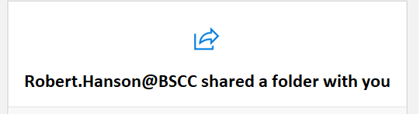
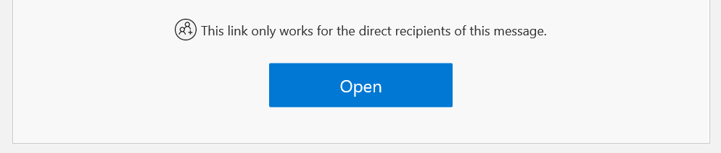
How to locate the Invoice Workbook
Notes:
When you are emailed the link for OneDrive it will look something like this, with a blue box on the bottom giving you the option to open.
When you click on it for the first time, it will require you to enter your email and then it will send you a passcode. You will need to enter the code the first time you try to get in, but it should not require again it after the initial log in.
Keep the email in a safe place, since it is your link to the workbook, but I can also send it again if needed. You can ONLY access it through the email sent directly to you. The link will NOT work for someone with a different email if you forward your shared file email to them.

Slide 5
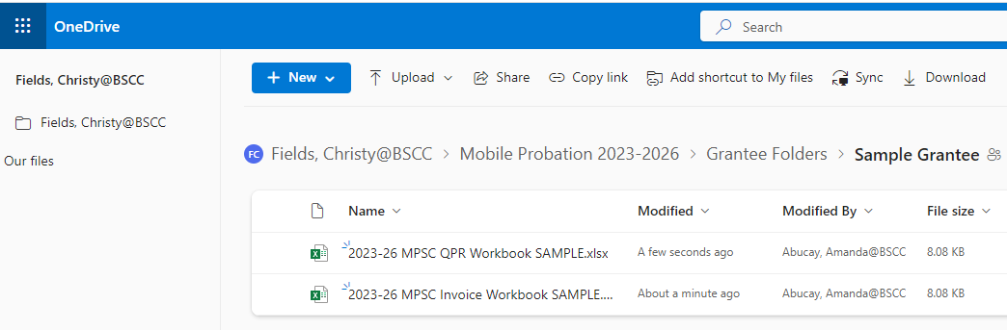
OneDrive Folder
Complete the invoice within OneDrive. This will ensure that you’re always using the most updated and current version of your workbook.
Please do not download and save a copy of the workbook onto your computer.
Notes:
Once you have clicked the link and gained access – you will see a screen that looks like this. Here is where you will find your invoice workbook as well as your annual progress report template.
Because of version control issues, please do not download the invoice workbook to your local drive and reupload it to the folder to submit your invoice. Since invoices are housed in OneDrive, every change that you make within the workbook is automatically saved. There’s no need to download it or save it locally on your computer.

Slide 6

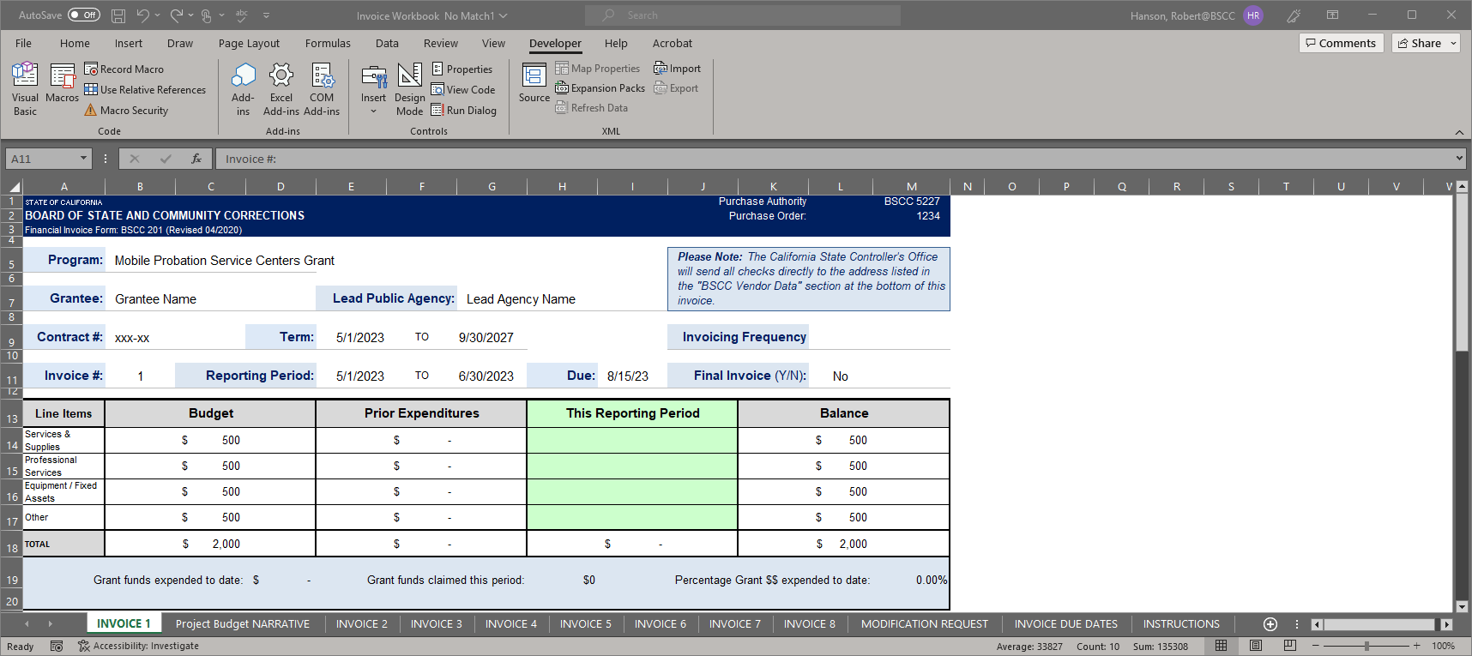
Forms Included in the Invoice Workbook
The Invoice Workbook is an Excel file arranged by worksheet tabs. The tabs included are listed below:
Financial Invoices
A Modification Request Form
Project Budget Narrative
Invoice Due Dates
Instructions
Notes:
Once the invoice is open, you will see something like this. It will include tabs for each quarterly invoice for the entire grant period. The workbook will also include a budget modification tab, a project budget narrative that outlines your project’s specific narrative submitted with your application, a tab for invoice due dates and the last one includes instructions.
The project budget narrative tab will always be located right next to the invoice that is due. This will allow for easy reference when completing your invoice.

Slide 7

Poll Question –
Invoices are kept…
On your desktop
On OneDrive
In an email
Notes:
Drop your answers in the chat -
Poll #1:
Invoices are kept:
A) On your desktop
B) On OneDrive
C) In an email

Slide 8

Your Invoices are located on OneDrive. You will receive an email containing the link to the folder.

Slide 9
Let’s Take a Look at your Invoice Workbooks…

Slide 10
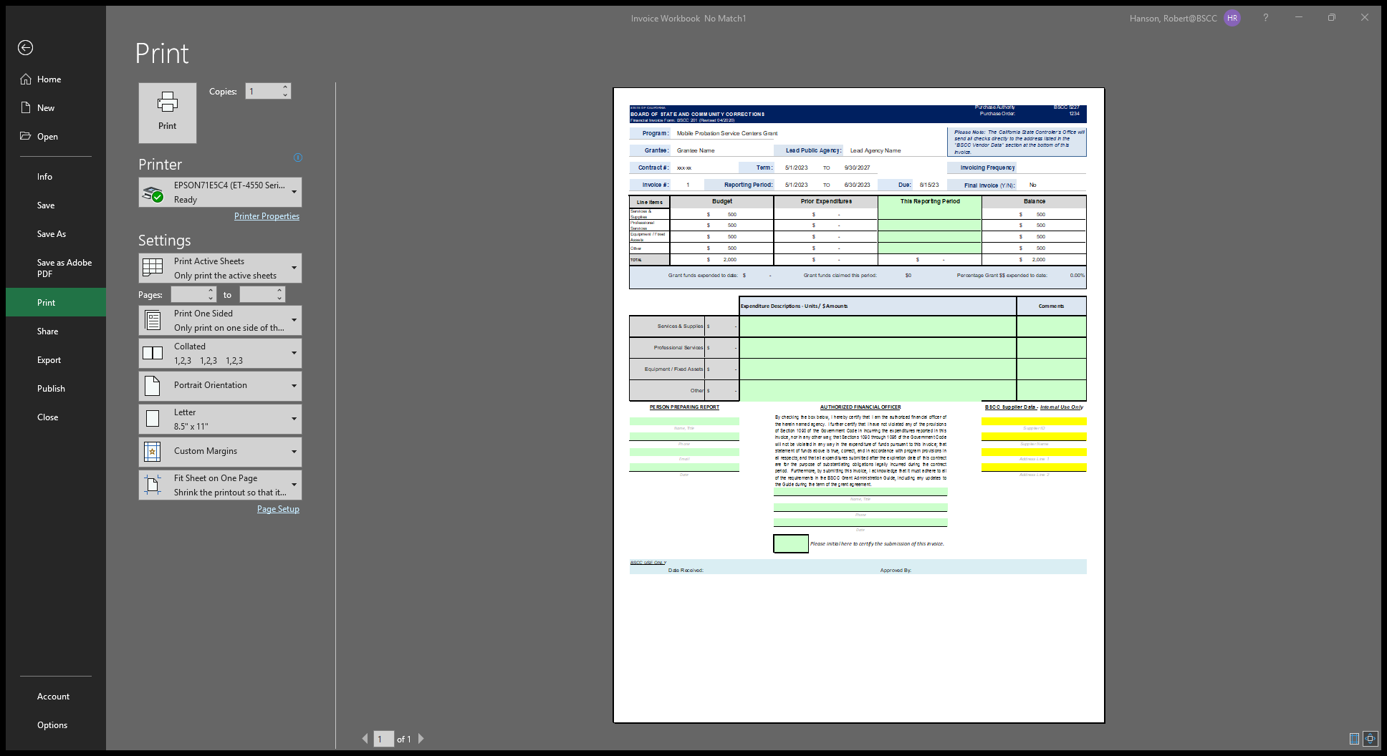
Financial Invoice - Form BSCC 201
Invoices need to be completed and submitted on a quarterly basis
The Invoice Form is your request for Payment. Once approved, it is sent to Accounting to be processed
Notes:
This is what your invoice worksheet looks like. Please note that only the green fields are unlocked and editable. All other fields are locked.
Invoices must be submitted on a quarterly basis and are due 45 days after the quarter ends -- even if there were no expenditures – please submit a signed $0 invoice. If you do have expenditures to claim, this serves as your request for payment and will be sent to BSCC’s accounting dept. once it has been approved by the field rep.

Slide 11
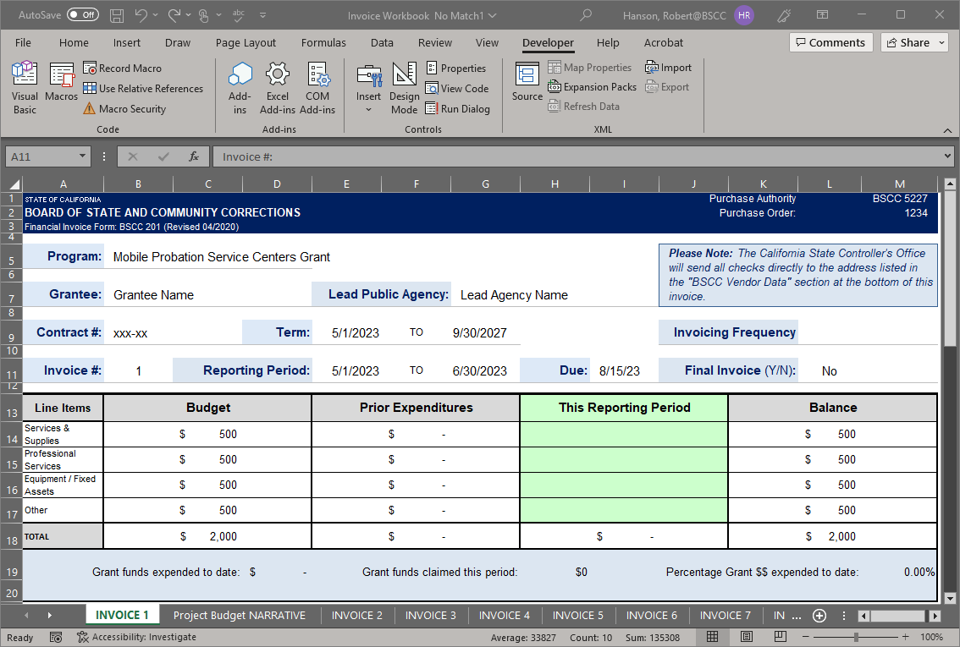
Financial Invoice Form BSCC 201
Confirm the Reporting Period
In the green section titled “This Reporting Period”, enter the line-item expenditures incurred during the reporting period.
Expenditures should be rounded to the nearest whole dollar.
Notes:
Prior to filling out your invoice, be sure to confirm the reporting period is correct and corresponds to the dates of the expenditures that you are requesting reimbursement for. You will be filling in the green section under “This Reporting Period” – all other sections will be prefilled with your corresponding budget.

Slide 12
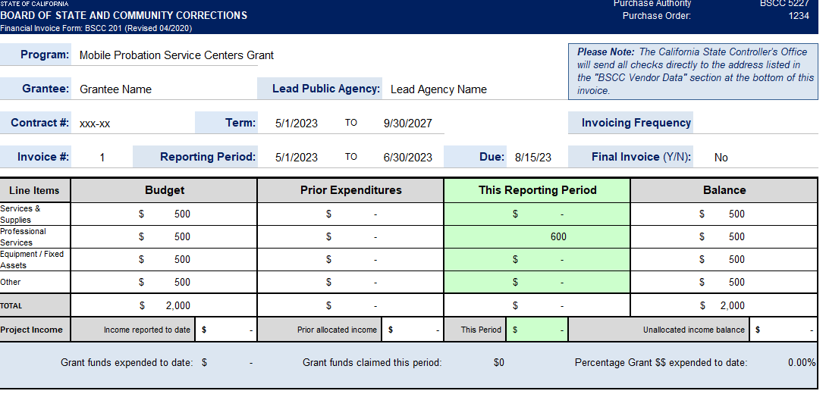
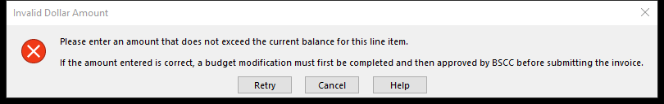

Financial Invoice - Form BSCC 201
There are two common errors you will come across:
If an amount entered is greater than the available balance, an error message will appear.
You will also get an error message if you enter the Change.
The Warning for both are the same
Notes:
Some common errors you might encounter when completing your invoice:
If the dollar amount you enter higher than the available remaining balance in that category, you will get an error message that will prompt you to either enter a lower dollar amount or complete a budget modification (if necessary). Another reason you might received an error message, is if you are entering a dollar amount with cents. Please ensure that you are only claiming amounts rounded to the nearest whole dollar.
On this example shown here at the top of the screen, the grantee’s remaining budget was only $500 however $600 was being claimed, which exceeds to the available balance on that line item. In this instance, you would either claim a lower amount, or you may request to submit a budget modification to reallocate some funds.

Slide 13
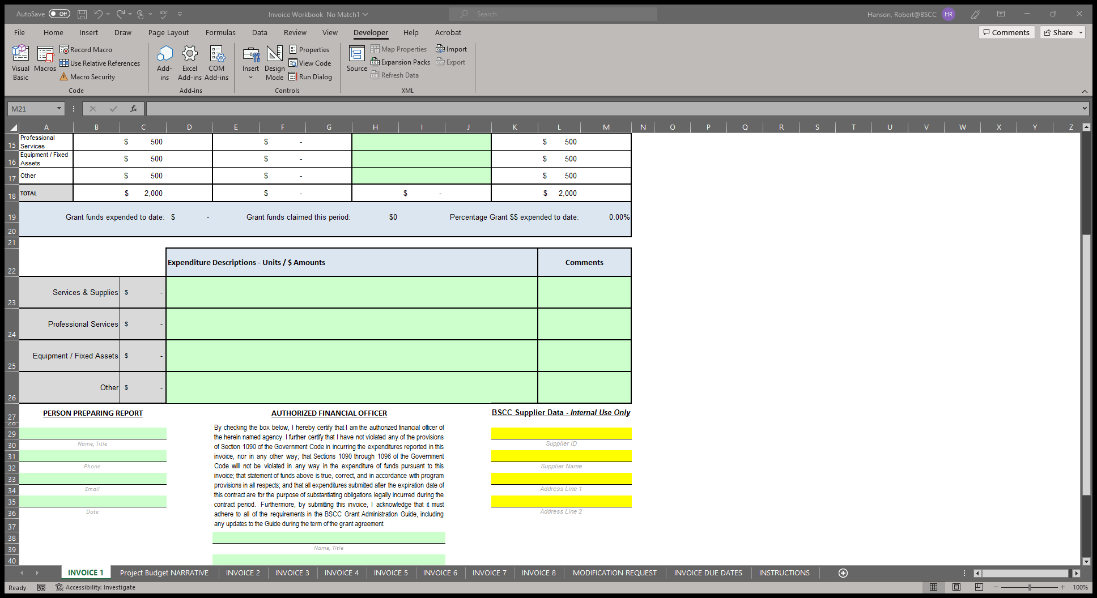
Financial Invoice - Form BSCC 201
This is what the expenditure description looks like for the Mobile Probation Service Centers Grant
For each dollar amount entered as an expenditure, enter a brief description in the corresponding Expenditure Description cell on what the cost is associated with
Notes:
Here is the narrative section of the invoice form. Each dollar amount listed on the top half will auto populate here in the gray section next to the corresponding line item. For each dollar amount entered as an expenditure, you will need to provide a detailed description of the costs being claimed. Your expenditures descriptions should correlate to the Project Budget Narrative, which is listed on its own tab next to the invoice that is due. You may also add additional information within the comment cells to the right if you need to provide any additional clarification.

Slide 14
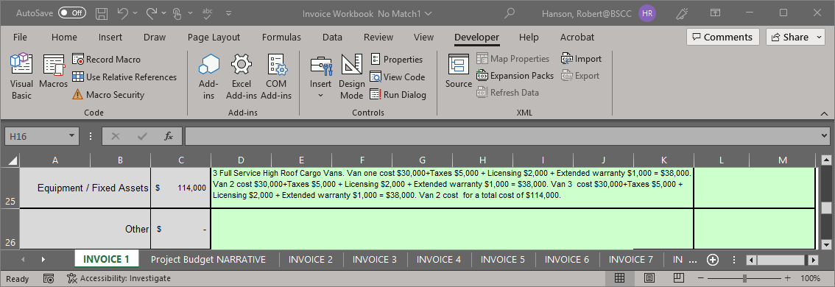
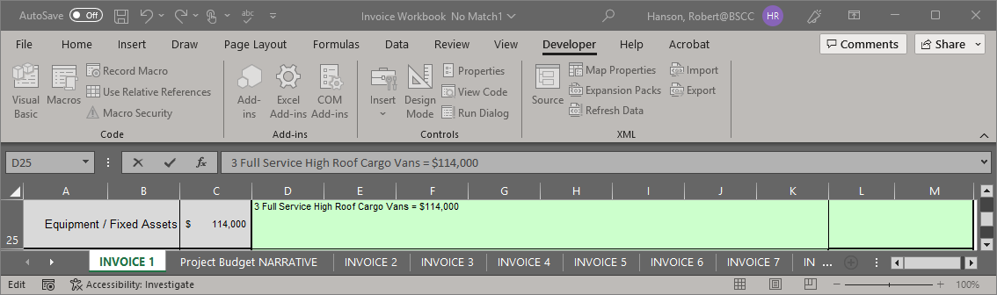
EXAMPLE of Expenditure Descriptions
DO THIS…
NOT THIS…
Please Make sure that the dollar amount in the description equals the dollar amount Shown to the left
Notes:
Please be detailed with your narrative description. Every expenditure that you claimed, should list the cost per unit, how many units you purchased, and the total amount. Please make sure that any naming conventions or items you list, are consistent with what is in your Project Budget Narrative.

Slide 15
Poll Question –
If there were no expenditures during the quarter, you should:
Do nothing
Find something to claim
Submit a $0 Invoice
Notes:
Drop your answers in the chat –
Poll #2:
If there were no expenditures during the quarter – you should:
A) Do nothing
B) Find something to claim
C) Submit a $0 invoice

Slide 16
Poll Question –
When completing your invoice form, you should always:
Just claim what sounds right to you
Refer to your Project Budget Narrative
Claim what was expensed on your previous invoice
Notes:
One more question!
Poll Question: When completing your invoice form, you should always:
Just claim what sounds right to you
Refer to your Project Budget Narrative
Claim what was expensed on your previous invoice

Slide 17
Always submit an invoice, even if you didn’t have any project expenditures for that quarter.
Always refer to your Project Budget Narrative when completing an invoice.
Questions?

Slide 18
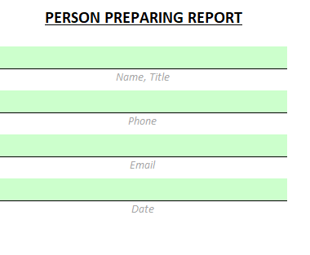
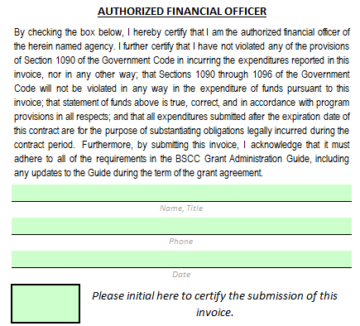
How to Approve and Certify Invoices
The Authorized Financial Officer is identified in the Grant Agreement and/or Grantee Contact Information Sheet. The Authorized Financial Officer cannot be the Project Director or the individual preparing the invoice.
Financial Invoices and Budget Modifications: The Authorized Financial Officer must review each line-item expenditure and description. Then, approve the invoice by providing their contact information and the date of approval.
To submit your invoice:
The Authorized Financial Officer must send an email to the Mobile Probation Service Centers inbox at MobileProbation@bscc.ca.gov stating that the invoice is complete and ready for BSCC review.
Notes:
This is the bottom section of the invoice form. This is the last section before certifying and submitting your invoice.
The person preparing the report and the Authorized Financial Officer must be two separate people. We cannot accept your invoice if the same person is listed in both sections or if a section is left blank. If this occurs, we will send your invoice back to you for corrections. Please make sure that all green sections are completed.
Please also note: the Authorized Financial Officer cannot also be your Project Director. (This is for checks and balances)
Once the invoice is filled out, the Person Preparing the Report must electronically sign the invoice by filling in their name and contact information as well as the date, before the Authorized Financial Officer completes their review and certifies the invoice.
The Authorized Financial Officer, after reviewing the invoice, must fill in their info and initial the square box at the bottom of the invoice to certify it.
To submit your invoice, the Authorized Financial Officer must send an email to the Mobile Probation Service Centers inbox at MobileProbation@bscc.ca.gov stating that the invoice is complete and ready for BSCC review.

Slide 19
Poll Question –
Can the “Authorized Officer” also be the person listed as the “Person Preparing Report”?
Yes
No
Notes:
Poll #4:
Can the “Authorized Officer” also be the person listed as the “Person Preparing Report”?
Yes / No
Poll #5:
How do you submit your invoice?
Fill it out on OneDrive and leave it alone
Download a copy of your workbook and email it
AFO sends an email to the Mobile Probation Service Centers inbox stating that the invoice is complete and ready for BSCC review

Slide 20
Poll Question –
How do you submit your invoice?
Fill it out in OneDrive and leave it alone
Download a copy of your workbook and email it
The Authorized Office sends an email to the MPSC inbox starting that the invoice is certified and ready for submission and BSCC Review
Notes:
Poll #5:
How do you submit your invoice?
Fill it out on OneDrive and leave it alone
Download a copy of your workbook and email it
The Authorized Office sends an email to the MPSC inbox starting that the invoice is certified and ready for submission and BSCC Review

Slide 21

MobileProbation@bscc.ca.gov
MobileProbation@bscc.ca.gov
MobileProbation@bscc.ca.gov
Notes:
This is the email you can send any questions or issues to as you begin working on your invoices and reports. We check it regularly and will always get back to you as quickly as possible.
Any questions before moving on??

Slide 22
Budget Modifications
A budget modification does not change the Grant Award amount or the grant cycle.
It is the grantee’s responsibility to obtain prior approval from the Field Representative for budget and program modifications before submitting the formal request.
Once the Field Representative pre-approves the need for a modification, the grantee may submit a formal Modification Request Form.
Notes:
A couple of things about budget modifications:
A budget modification does not change the Grant Award amount or the grant cycle.
It is the grantee’s responsibility to obtain prior approval from the Field Representative for budget and program modifications before submitting the formal request.
Once the Field Representative pre-approves the need for a modification, the grantee may submit a formal Modification Request Form.

Slide 23
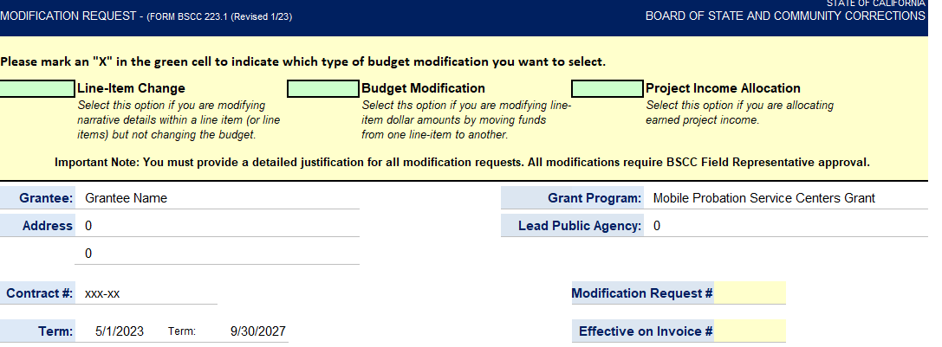
Modification Request - Form BSCC 223.1
The grantee shall select Line-Item Change or Budget Modification on the form
Notes:
When beginning your modification, please mark an “X” to indicate which type of budget modification you will be completing. Select the Line-Item change option if you are modifying narrative details within a line item and not reallocating funds from one line item to another.
Select Budget Modification if you are modifying line items dollar amounts by moving funds from one line-item to another.
There is a third option for “Project Income Allocation” but this grant does not allow for project income so this will not apply to our Mobile Probation Grantees.

Slide 24
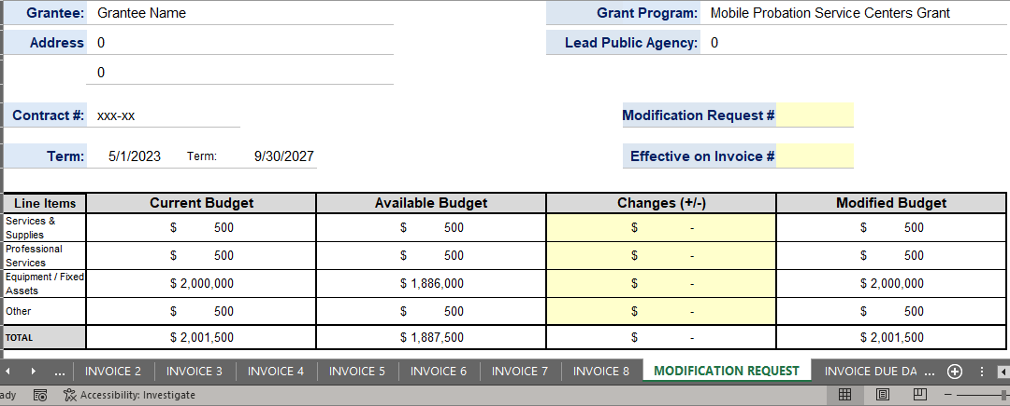
Modification Request - Form BSCC 223.1
In the Changes (+/-) section, The grantee will enter either + or - followed by the dollar amount which will populate the Modified Budget section.
After changes have been entered, the Total in the Changes (+/-) section must equal zero.
If the grantee is requesting a program modification or a Line-Item change, the Changes (+/-) section may be left blank.
Notes:
Much like the invoice worksheet, only the colored cells are editable. For budget mods, the cells are yellow.
Be sure to fill in all yellow fields including which invoice you’d like the modification to take effect.
If you are moving funds from one line-item to another, you will enter the amounts in the “Changes” section. Please note: If you try to move more funds out of a line-item than what is remaining in your available budget, you will get an error message.
Once the changes are made, you want to make sure that the Total is zeroed out.
If you’re only requesting a line-item change, the “Changes” section may be left blank.

Slide 25
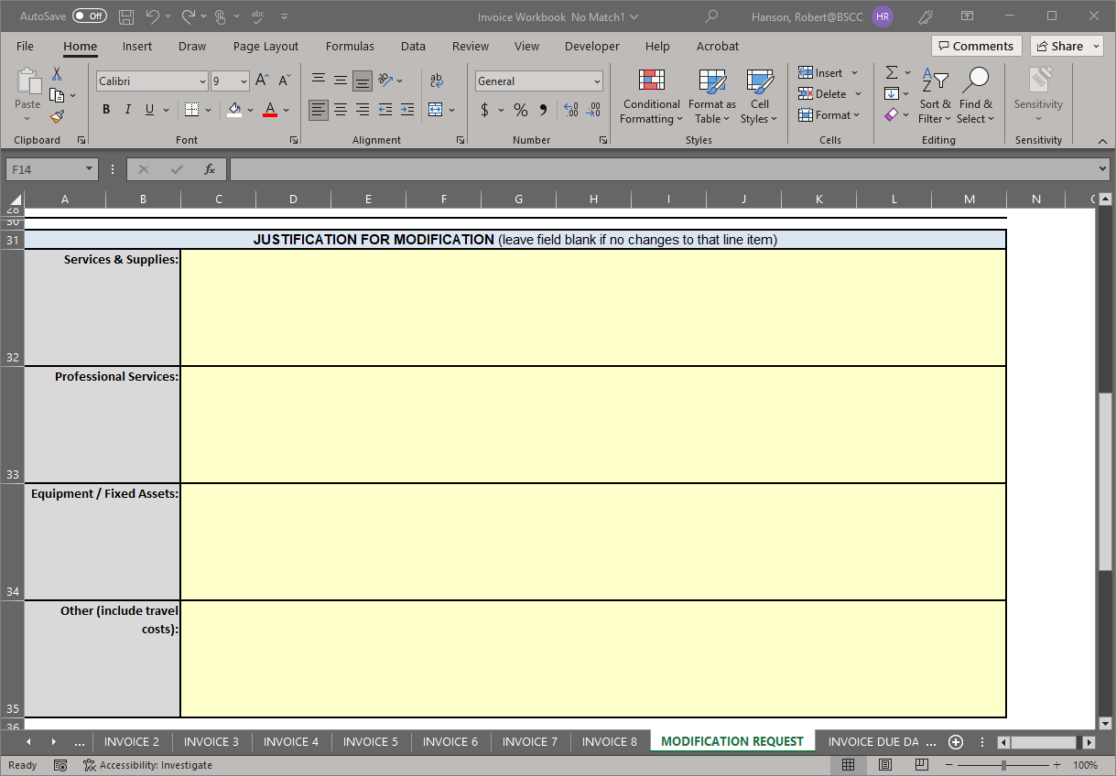
Modification Request - Form BSCC 223.1
Prove a detailed justification and updated project budget narrative for each line-item you are requesting a modification for.
Once the BSCC staff reviews and approves the budget modification, the updated invoice workbook will be made available on the OneDrive.
Notes:
The justification section should be filled out to support any changes you are making to your budget. Be sure to add narrative detail to the appropriate line-item. Once the modification request has been reviewed and approved, I will email you to let you know and your workbook will be updated on OneDrive.

Slide 26
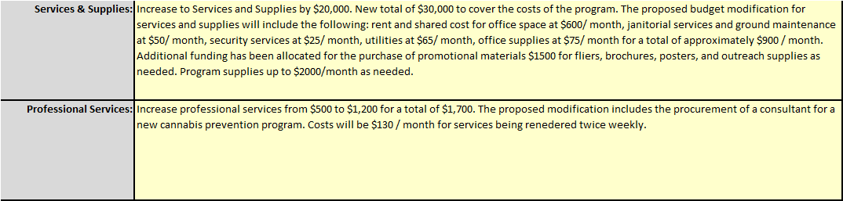
Sample Budget Modification Justifications:
Do This
Not This
Notes:
This just an example of the level of detail for your justification that we’re looking for.

Slide 27
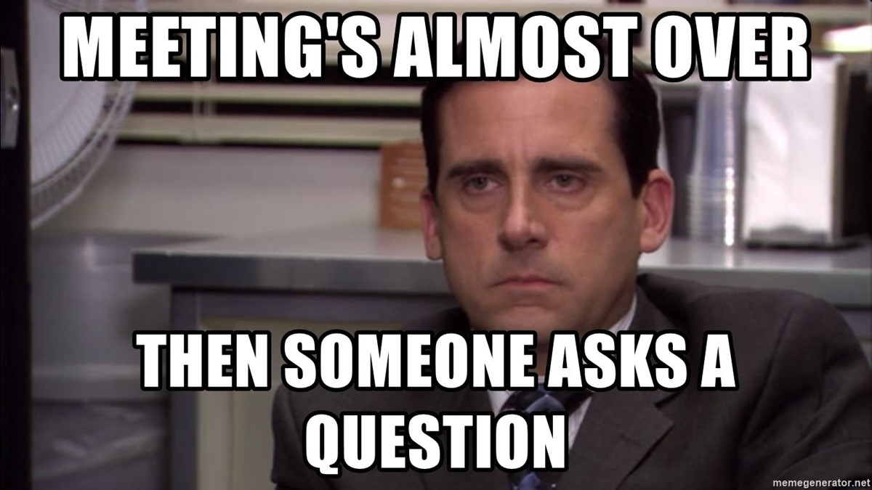
Questions?

Slide 28
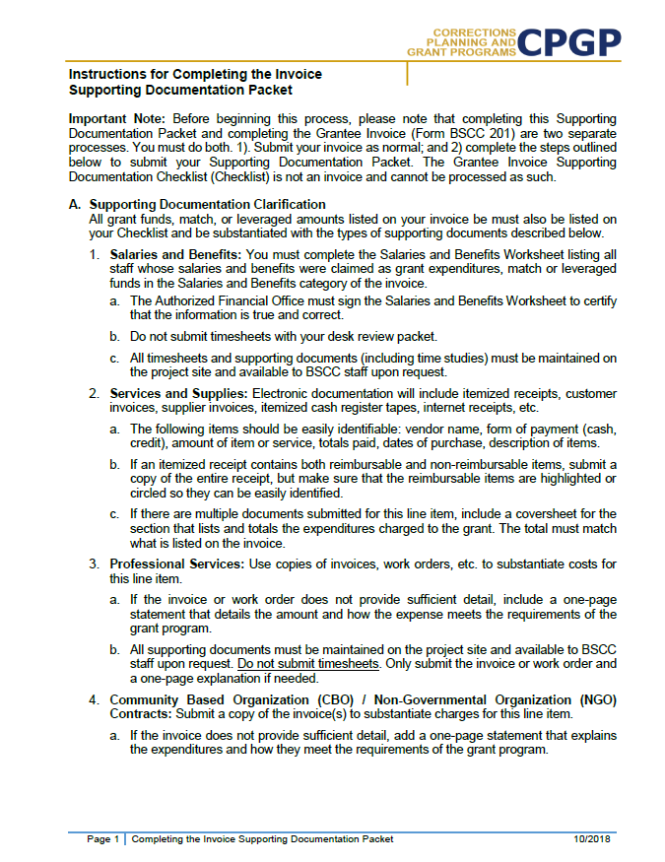
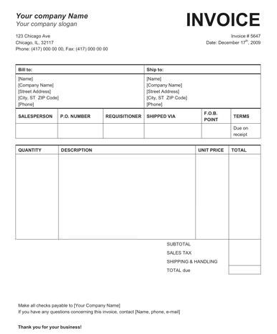
Desk Review Process and Supporting Documentation
Separate from the Financial Invoice
Grantees must complete both the Desk Review Packet and Financial Invoice
Supporting documents not required for every invoice, unless requested by BSCC
Grantees must maintain supporting documentation for all grant expenditures claimed on invoices.
All supporting documentation must be maintained by the grantee on site and be readily available for review during BSCC site visits
Examples of supporting documentation: receipts, invoices, work orders, Field Representative approvals, etc.
Notes:
The desk review is an assessment of the fiscal components of a grant project funded through a BSCC RFA or RFP process. Fiscal desk reviews are completed by Program Analysts and upon completion of a fiscal desk review, the Grantee will be notified of the outcome. In the event a fiscal desk review identifies a concern, the Field Representative and Manager will be informed and will provide direction for resolution. The record of each outcome will be filed in the grant project file.
It’s important to note that the Desk Review is separate from the Financial Invoice. Grantees must complete both the Desk Review Packet and the Financial Invoice when requested. You will not need to submit supporting documentation with every invoice, but it’s important to keep all supporting docs readily available in the event that BSCC requests it. You will be notified in advance when a Desk Review is wit an invoice.

Slide 29
Preparing Invoice Supporting Documentation Packet
Compile, highlight and label all project related receipts
Dates on all supporting documents must fall between grant start date and the end date of the applicable reporting period
Types of supporting documentation that should be provided for each category can be located within the instructions
Notes:
When putting together your Supporting Documentation Packet to submit for your Desk Review, you’ll first want to start by gathering all project related receipts for each reimbursable expense claimed on the invoice in which you are completing the desk review for. You will need to label all documents that you are submitting with the Budget line item name and document number. For Example, Services & Supplies Document #1, Services and Supplies Document #2, etc. Handwritten labels your supporting docs are fine.
Only expenses that are incurred and paid for by the grantee during the grant cycle and before the end date of the applicable invoicing period are eligible expenses. It is important to note that his means the dates on all supporting documents must fall between grant start date and the end date of the applicable reporting period.
Additional information regarding Supporting Documentation can be found in the BSCC Grant Administration Guide on our website.

Slide 30
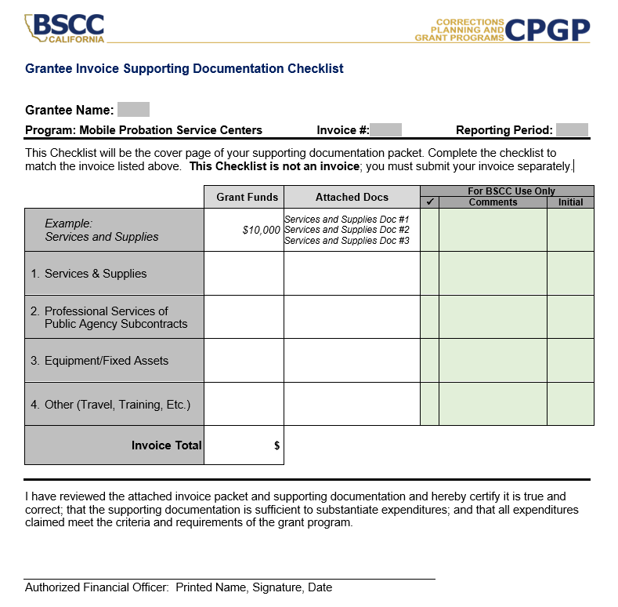
Invoice Supporting Documentation Packet
- Grantee Invoice Supporting Documentation Checklist -
Must be submitted with every Desk Review.
Every item on the invoice must have sufficient supporting documentation to substantiate exact amount claimed for reimbursement.
You will list the amount and support documents provided for each category here.
Must be signed and dated by the Authorized Financial Officer.
Notes:
This is what the Grantee Invoice Supporting Documentation Checklist looks like. This checklist must be included with each supporting documentation packet you submitted.
As you can see, the line items listed on the checklist are the same ones listed in your budgets and your invoices.
At the top of the form, you will need to enter your department’s name, which invoice number and reporting period you’re providing supporting documentation for. You’ll then complete the table as it relates to the invoice, filling in whichever line items are applicable.
You will list the amount claimed on each line item and the name of the attached supporting document provided for each category.

Slide 31
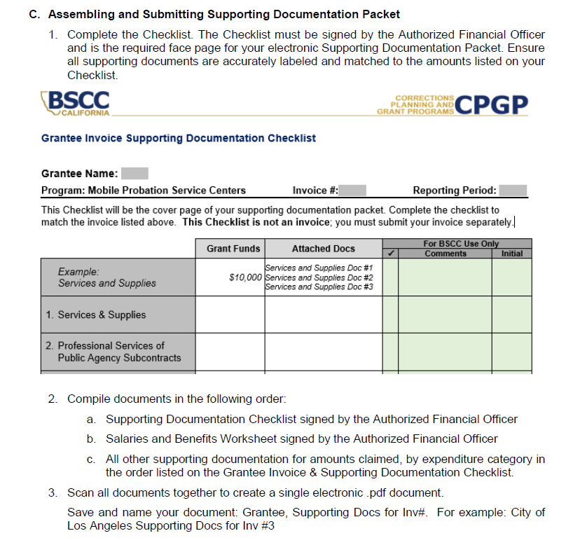
Invoice Supporting Documentation Packet
- Assembling and Submitting -
Ensure all supporting documents are accurately labeled and matched to the amounts listed on your Checklist.
Compile documents in the order outlined on the Checklist
Scan into a single PDF and email to the MobileProbation@bscc.ca.gov inbox or upload it into your OneDrive folder.
Notes:
When you assemble your packet, please ensure that all supporting documents are accurately labeled and that they match the amount listed on the checklist.
Once all supporting documents are labeled and accurately matched to the invoice, the Authorized Financial Officer must sign the bottom of the checklist.
This checklist will be the face page for the Desk Review Packet.
Please scan all of your documents into a single PDF file and email either email it to mobile probation inbox or you can upload it to your OneDrive folder if the file is too large to email.
I know this is a lot of information, but we can always provide additional guidance and assistance when the time comes for you to submit your desk review.

Slide 32

Questions?

Slide 33
Important Reminders:
Always refer to the Project Budget Narrative tab to verify that you are charging the correct items allowed for your grant before you submit your invoice for payment.
Even if you have no expenditures, you still need to submit a signed invoice for approval.
The person completing to invoice has to be different from the person approving the invoice.
Notify your field rep. before submitting a budget modification to get their approval.

Slide 34
Grantee Presentations
(3-5 minutes)
One spokesperson from each project
Please provide:
  Project name
  Introduce team members on the call – name(s) and role(s)
  Briefly describe the project’s focus and goals

